Slide 1
Appliances’ Energy Consumption Prediction Based on House Temperature and Humidity Conditions and Meteorological Variables
Mehdi Salehi
Springboard Data Science Track
Capstone Two Final Report

Slide 2
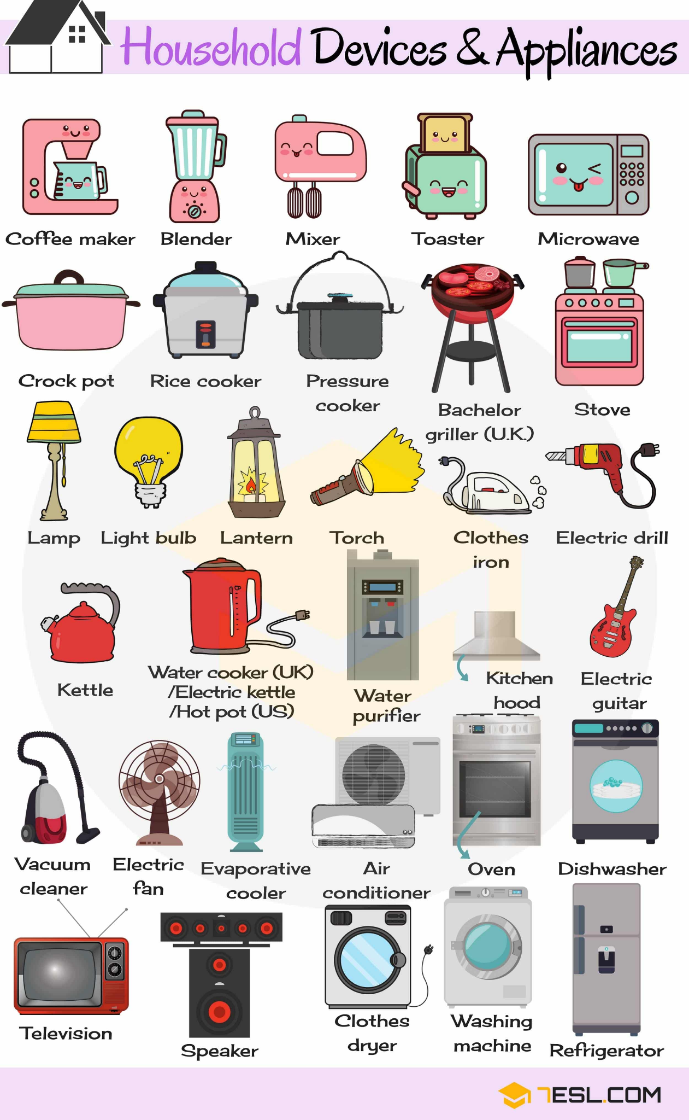
The Problem
We are very dependent on energy supply
How a consumer’s house environmental conditions and meteorological variables will affect appliances' energy consumption?
Develop a predictive machine learning model to estimate appliance energy consumption from those attributes.
How important is each attribute and its effect on appliances energy usage?
Can we predict the usage based on these attributes?

Slide 3

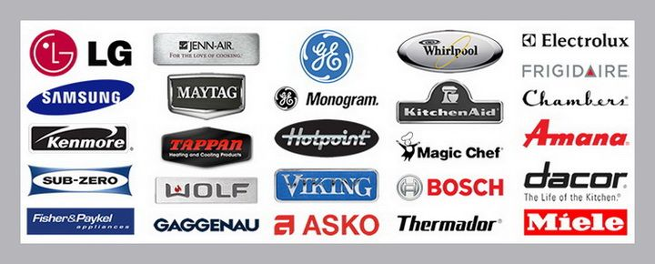




Who Cares?
Utility / Power Companies
Appliances Manuf Companies

Slide 4
What factors might affect energy usage?
Household conditions
Meteorological variables
Temperature
Humidity
Hour of day
No of household members
Type / Size of home, etc…
Geographic location / Climate
Temperature
Humidity
Wind Speed
Pressure, etc…

Slide 5
Data Source & Information
The data set obtained from the UC Irvine Machine Learning Repository of appliances energy use in a low energy building (https://archive.ics.uci.edu/ml/machine-learning-databases/00374/)
Household conditions
Meteorological variables
Data collected at 10 min intervals for about 4.5 months (January to April 2016)
The house temperature and humidity conditions were monitored with a ZigBee wireless sensor network
The wireless data was averaged for 10 minutes periods
The energy data was logged every 10 minutes with m-bus energy meters
Weather from the nearest airport weather station (Chievres Airport, Belgium) was downloaded from a public data set from Reliable Prognosis
Merged together using the date and time column.

Slide 6
Data Wrangling
Data set contained 19735 rows (entries) with 29 attributes (columns)
All the columns were numerical, except for the date column
There were two random variables included
Appliances is the electricity usage in Wh for appliances in the house (our target variable)
Other columns are potential features
No missing or duplicate values
Columns were renamed for more readability
Two random variables were removed
Date column was converted into date type

Slide 7
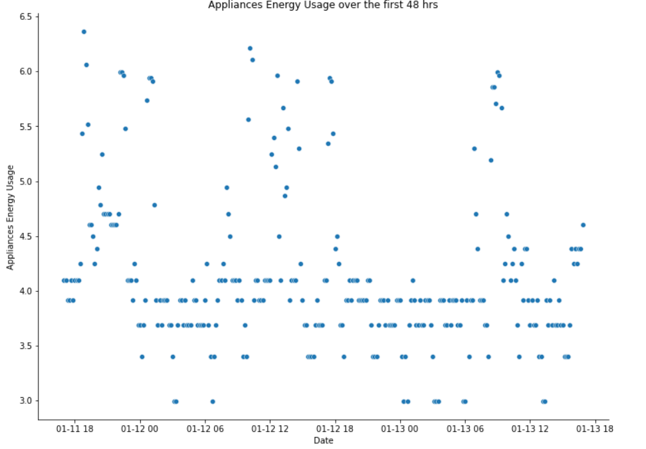
Exploratory Data Analysis
Peak Usage
(Evening)
Peak Usage
(Noon)
Peak Usage
(Morning)

Slide 8
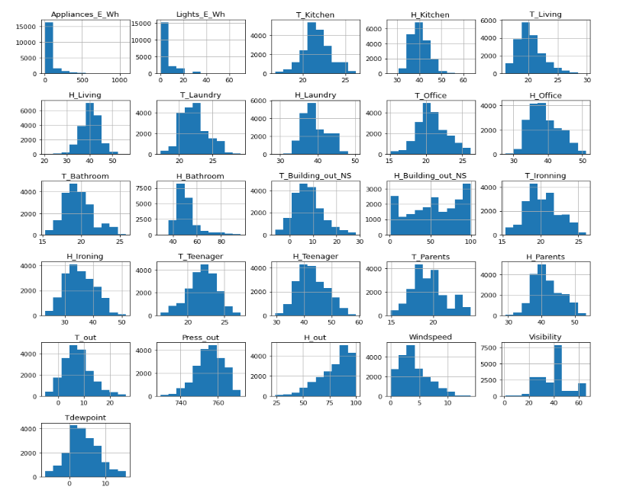
Exploratory Data Analysis
Our target is not normal
appliances energy consumption is cyclic

Slide 9
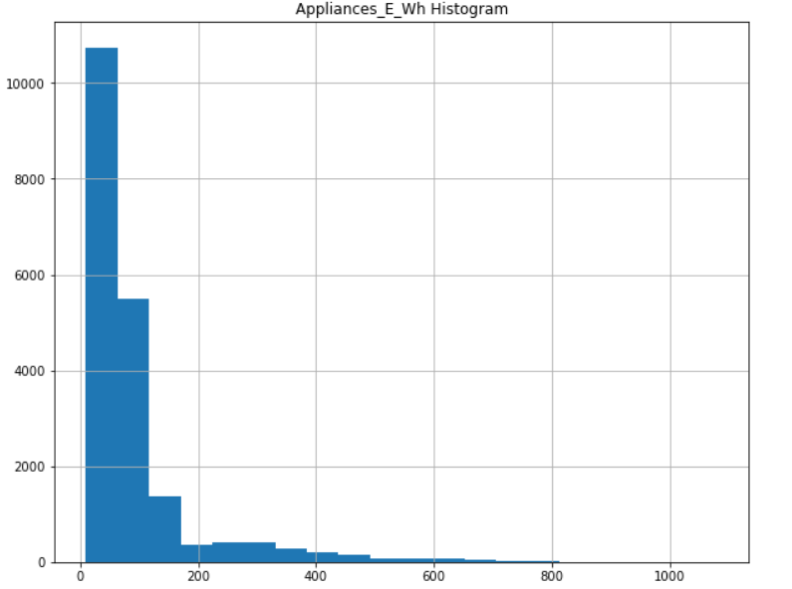
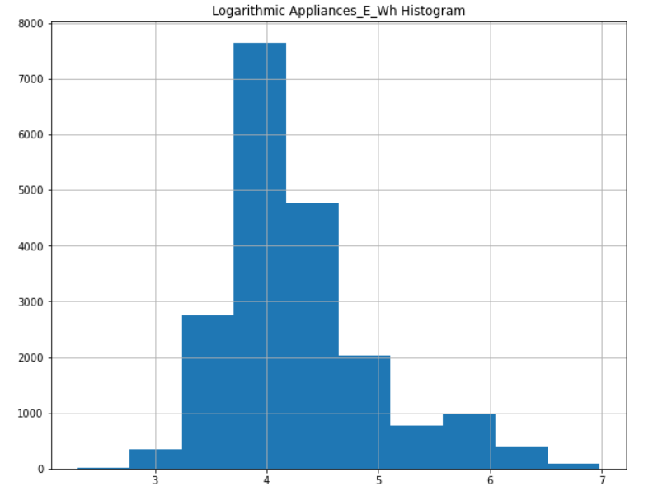
Exploratory Data Analysis
Log Transform
appliances energy consumption is cyclic

Slide 10
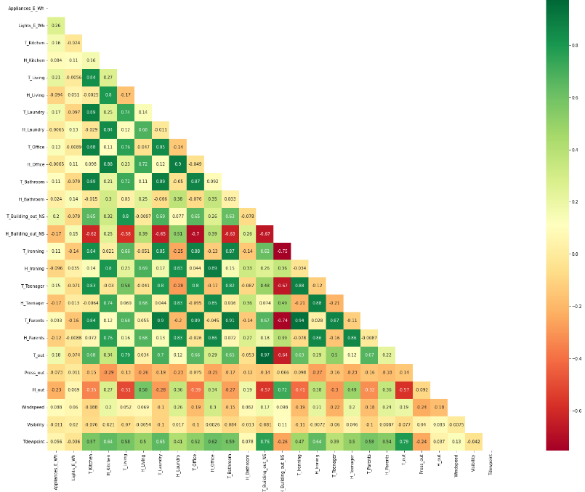
Exploratory Data Analysis
Top six most contributing factors: Lights_E_Wh, H_out, T_Living, T_Building_out_NS, T_out, & H_Building_out_NS
Target variable is positively correlated with temperature and negatively with humidity
Temperatures are strongly and negatively correlated with H_Building_out_NS and to less extent with H_out.
appliances energy consumption is cyclic

Slide 11
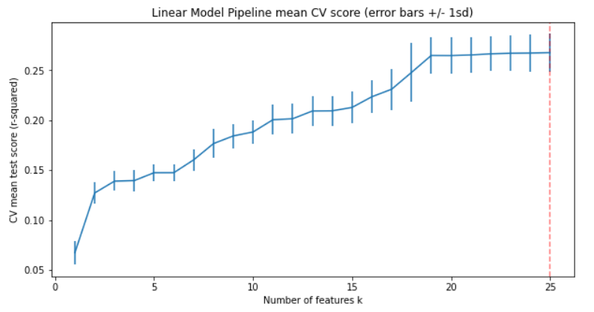
Preprocessing and Training Data Development
Preprocessing Steps:
Defined X (features) and y (target variable)
Created a 70/30 train and test split
Scaling
Optimum number of features (linear model, CV)
All 25 features give the best performance during the training

Slide 12
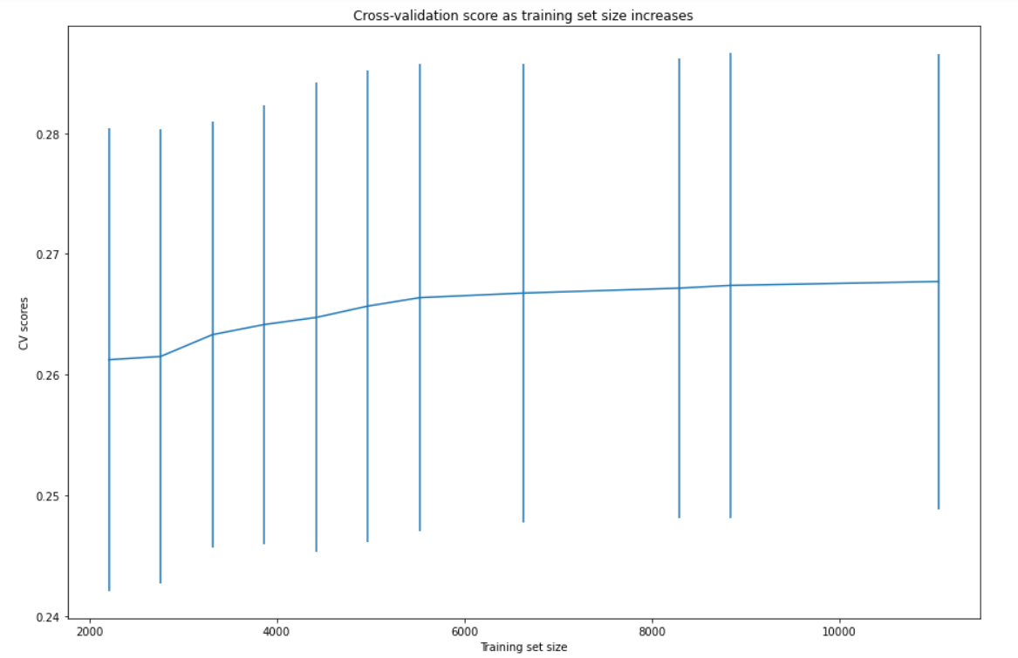
Preprocessing and Training Data Development
Data Quantity Assessment:
Do we have enough data in our training set?
Using learning_curve & CV with a linear model
Initial improvement in model score as sample size increases
Model performance levels off around a sample size of 8840
Training data set includes 13814 entries

Slide 13
Machine Learning and Modeling Overview
Type: Supervised Learning
Algorithms used:
Linear Regression
Random Forest
Gradient Boosting
Extreme Gradient Boosting
Performance Evaluation Using Test set
Cross validation (CV) for hyperparameter tuning:
3 fold cv (100 iteration, 300 runs)
Using scikit-learn’s randomized grid search
Evaluation metric: R-squared
Training using optimal parameters

Slide 14
Modeling Comparisons
Model | R-Squared | MAE | MAPE (%)
Linear Regression | 0.280 | 0.395 | 8.9
Random Forest | 0.379 | 0.359 | 8.2
Gradient Boosting | 0.618 | 0.274 | 6.3
Extreme Gradient Boosting | 0.670 | 0.249 | 5.6
Tuned RF | 0.724 | 0.227 | 5.2
Tuned GB | 0.714 | 0.235 | 5.4
Tuned XGB | 0.728 | 0.226 | 5.2
Linear Regression is the worst and Tuned XGB is the best model

Slide 15
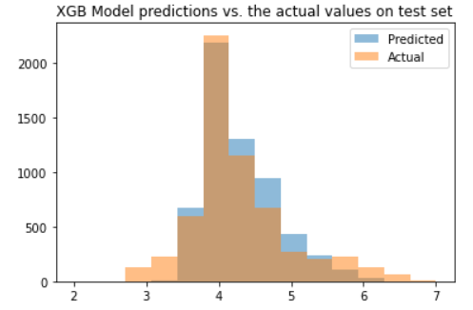
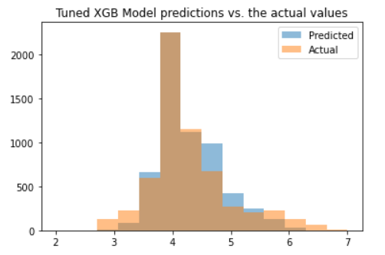
Details of the Best Model (Tuned XGB)
Base Model:
n_estimators = 100
max_depth = 6 learning_rate = 0.3
colsample_bytree = 1
colsample_bylevel = 1
Tuned Model:
n_estimators = 1800 max_depth = 20
learning_rate = 0.01
colsample_bytree = 0.7
colsample_bylevel = 0.4

Slide 16
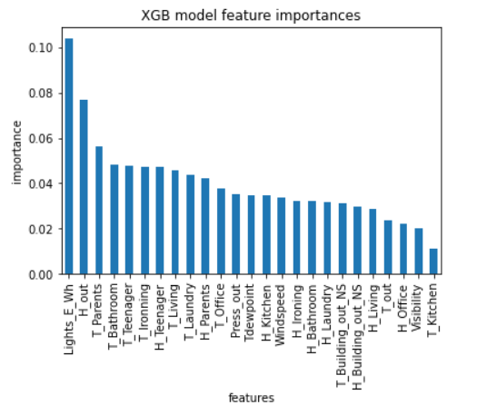
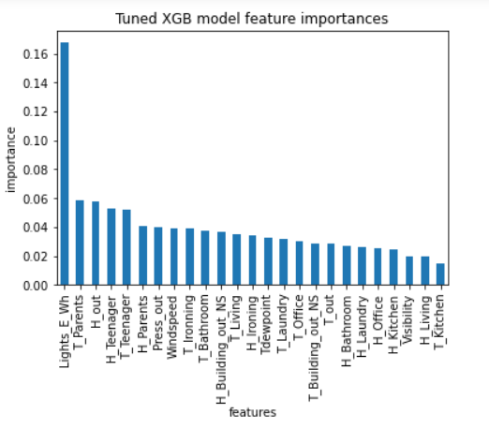
Details of the Best Model (Tuned XGB)
Base Model
Tuned Model

Slide 17
Example of Model Usage
The models can be used to simulate and forecast the energy consumption of appliances considering interior and exterior conditions of a household.
For example, how installing a humidifier or dehumidifier in a house will affect energy consumption (increase or decrease in humidity)
How the orientation of the house (facing north or south) will affect the energy consumption
Model can also be used in combination with weather forecasts to predict the possible increases or decreases in energy loads, especially when considering more than one individual household in a neighborhood or zip code, or even a city to scale the process

Slide 18
Conclusions
A predictive model was developed that predicts the energy consumption with an accuracy of of 74%
Out of 7 supervised regression models, the tuned Extreme Gradient Boosting provided the best results
All 25 features were used in the modeling
With 70%-30% splitting, the test data set gave MAE = 0.226
Top features in the subject household affecting the appliance energy consumption are: Lights_E_Wh, H_Teenager, and H_out

Slide 19
Ideas to Improve the Model in Future
Expand the study over a few households with different orientation of the house, appliances manufacturers, and # of people
Consider approximately to the weather station (airport)
Extend the study over a longer period of time to capture seasonality effects

